Slide 1
HTTP Protocol

Slide 2
Agenda
Definitions
HTTP Communication chain
HTTP Transport binding
HTTP Methods
HTTP Messages
HTTP Status Codes
HTTP Caching
Q&A

Slide 3
Communication Protocol?
A set of rules and regulations that determine how data is transmitted.

Slide 4
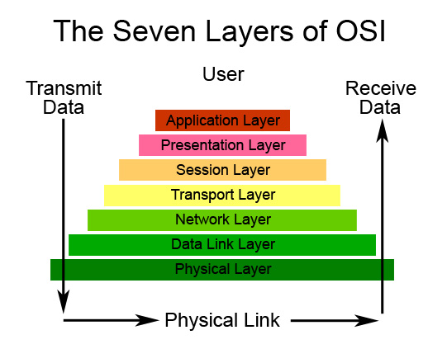
7 OSI layers
HTTP, SMTP, FTP, DNS…

Slide 5
HTTP protocol?
Hypertext Transfer Protocol
an application-level protocol for distributed, collaborative, hypermedia information systems (RFC-2616)
Not only text but graphics and multimedia
A part of TCP/IP protocols suite
Notes:
1.0 http://www.ietf.org/rfc/rfc1945.txt
1.1 http://www.w3.org/Protocols/rfc2616/rfc2616.html
2.0 http://tools.ietf.org/html/draft-ietf-httpbis-http2-04
The Hypertext Transfer Protocol (HTTP) is designed to enable communications between clients and servers.
HTTP works as a request-response protocol between a client and server.
A web browser may be the client, and an application on a computer that hosts a web site may be the server.
Example: A client (browser) submits an HTTP request to the server; then the server returns a response to the client. The response contains status information about the request and may also the requested content.

Slide 6
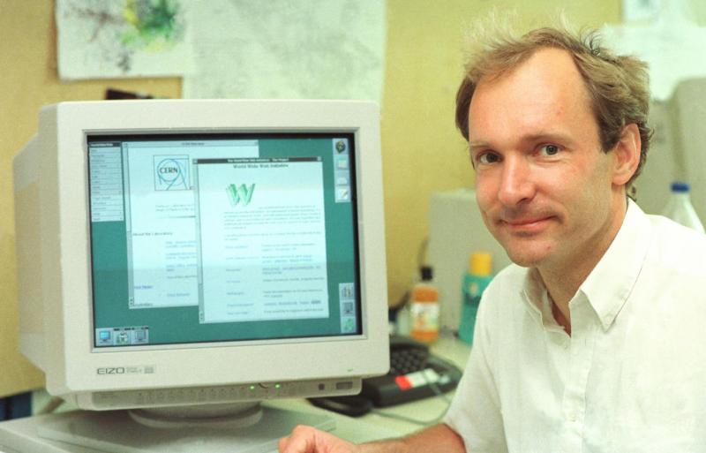
HTTP protocol?
History
1990 – HTTP/0.9
1996 – HTTP/1.0
1999 – HTTP/1.1
Next HTTP/2.0 (draft)
Notes:
0.9:
The first version of HTTP, HTTP/0.9, was part of the early World Wide Web and was a very simple request/response protocol with limited capabilities that could transfer only text files.
1.0 http://www.ietf.org/rfc/rfc1945.txt
The first widely-used version was HTTP/1.0, which is a more complete protocol that allows the transport of many types of files and resources.
1.1 http://www.w3.org/Protocols/rfc2616/rfc2616.html
Multiple host name. Multiple host on 1 IP
Performance, security
2.0 http://tools.ietf.org/html/draft-ietf-httpbis-http2-04

Slide 7


HTTP Communication chain
The HTTP protocol is a request/response protocol
A client sends a request to the server
The server responds data
Request
Response
HTTP Client
HTTP Server
Notes:
HTTP is a client/server-oriented, request/reply protocol. Basic communication consists of an HTTP Request message sent by an HTTP client to an HTTP server, which returns an HTTP Response message back to the client.

Slide 8
HTTP Communication chain
HTTP Request/Response Chain with Intermediaries
Request
Request
Response
Response
Intermediary
HTTP Server
HTTP Client
Proxy
Gateway
Notes:
Proxy: A proxy is a forwarding agent, receiving requests for a URI in its absolute form, rewriting all or part of the message, and forwarding the reformatted request toward the server.
Gateway: receiving agent. A router that routes the data transmission.

Slide 9
HTTP stateless protocol
Do not remember previous request/response chain
Request 1
Response 1
Request 2
Response 2
HTTP Client
How to maintain state?
HTTP Server

Slide 10
HTTP Transport binding
Transitory connection
One connection is created for each request/response
Persistent connection
The connection is kept open after each request/response set until the client is done requesting all the documents.
Notes:
Persistent connections are connections between a Web client and a server that can be reused for more than one exchange of a request and a response.
In HTTP/1.0, the default action for the server was to close the connection when it had received a request from the Web client and sent a response. If the Web client wanted the server to keep the connection open, it had to send a Connection: Keep-Alive header on the request.
For HTTP/1.1, persistent connections are the default. When a connection is made between a Web client and a server, the server should keep the connection open by default. The connection should only be closed if the Web client requests closure by sending a Connection: close header, or if the server's timeout setting is reached, or if the server encounters an error.
Persistent connections improve network performance because a new connection does not have to be established for each request. Establishing a new connection consumes significant additional network resources compared to making a request using an existing connection.
DEMO using telnet
Draw HTML document on the WHITEBOARD

Slide 11
HTTP Methods
GET (*)
HEAD (*)
POST (*)
OPTIONS
PUT
DELETE
TRACE
CONNECT
Notes:
http://www.w3.org/Protocols/rfc2616/rfc2616-sec9.html
Telnet demo Get and Head
GET: Retrieve a resource.
HEAD Like GET, but returns just the HTTP header.
POST create new resource
OPTIONS Get information about how the server allows to communicate with.
OPTIONS * HTTP/1.1 Host: example.com
HTTP/1.1 200 OK Date: … Allow: OPTIONS, GET, HEAD, POST, PUT, DELETE, TRACE Content-Length: 0
PUT Send data to the server.
DELETE Delete an existing resource.
TRACE Return the request headers sent by the client.

Slide 12
HTTP GET vs. POST
GET - Requests data from a specified resource
POST - Submits data to be processed to a specified resource
Notes:
Demo Web sniffer tool

Slide 13
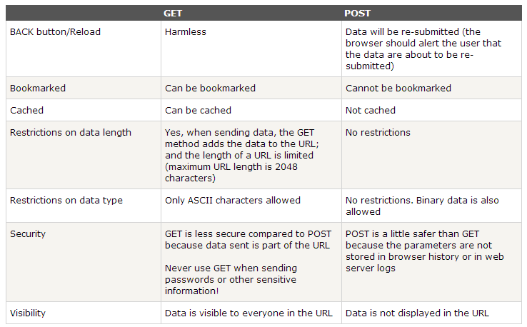
HTTP GET vs. POST

Slide 14
HTTP Message
Communication between devices using the HTTP takes place via HTTP messages
Two types: requests and responses.
Text-based message format.

Slide 15
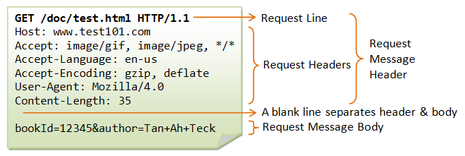
HTTP Request Message
Notes:
In this example, the client issues a GET request to ask for a document named "/index.html"; and negotiates to use HTTP/1.0 protocol. A blank line is needed after the request header. This request message does not contain a body.
The server receives the request message, interprets and maps the request-URI to a document under its document directory. If the requested document is available, the server returns the document with a response status code "200 OK". The response headers provide the necessary description of the document returned, such as the last-modified date (Last-Modified), the MIME type (Content-Type), and the length of the document (Content-Length). The response body contains the requested document. The browser will format and display the document according to its media type (e.g., Plain-text, HTML, JPEG, GIF, and etc.) and other information obtained from the response headers.

Slide 16
HTTP Request Headers
Accept:
tell the server what Internet media types it is willing to accept in a response
Accept: type/subtype; text/plain; image/jpg; */*
Accept-Charset
specifies what character sets the client is willing to accept in a response
Accept-Charset: iso-8859-5, UTF-8
Accept-Encoding
specifies what content encodings the client is willing to accept
Accept-Encoding: compress, gzip
Accept-Language
indicate what languages the client supports
Accept-Language: en-gb; vi-vn

Slide 17
HTTP Request Headers (cont.)
Host:
Specifies the Internet host
Host: www.vgu.edu.vn:8080
User-Agent
Specifies what agent (application) is sending the request
User-Agent: Mozilla/5.0
Cookie
Cookie data which previously set by the server
Cookie: user=1; category=pc;
Referer
the URL of the resource from which the URL of the current request was obtained
Referer: http://google.com

Slide 18
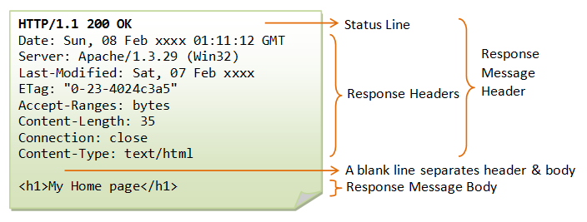
HTTP Response Message

Slide 19
HTTP Response Headers
Server
Server info that serves the request
Server: Apache/2.4.1 (Unix)
Expires
gives the date/time after which the response is considered
Expires: Thu, 20 Jul 2013 16:00:00 GMT
Refresh
Used in redirection, or when a new resource has been created.
Refresh: 5; url=http://www.vgu.edu.vn

Slide 20
HTTP Status codes
1xx (Informational): Request received, server is continuing the process.
2xx (Success): The request was successfully received, understood, accepted and serviced.
3xx (Redirection): Further action must be taken in order to complete the request.
4xx (Client Error): The request contains bad syntax or cannot be understood.
5xx (Server Error): The server failed to fulfill an apparently valid request.

Slide 21
Common HTTP Status codes
200 OK: The request is fulfilled.
301 Move Permanently: The resource requested for has been permanently moved to a new location
304 Not Modified: Server notifies that the resource requested has not been modified.

Slide 22
Common HTTP Status codes
400 Bad Request: Server could not understand the request (syntax error).
401 Authentication Required: The requested resource is protected, and require client’s credential.
403 Forbidden: Server refuses to supply the resource, regardless of identity of client.
404 Not Found: The requested resource cannot be found in the server.

Slide 23
Common HTTP Status codes
500 Internal Server Error: Server is error in the server-side program responding to the request.
503 Service Unavailable: Server cannot response due to overloading or maintenance. The client can try again later.
504 Gateway Timeout: Proxy or Gateway indicates that it receives a timeout from an upstream server.
Notes:
DEMO using chrome to access resources

Slide 24
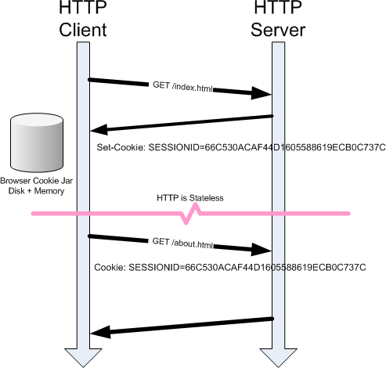
HTTP Cookie
HTTP is a stateless protocol. Cookies provide a mechanism to "maintain state".
Notes:
Important especially in authentication
No cookie -> no session
DEMO login google, yahoo

Slide 25
HTTP Caching
Cache: local copy of a resource
Request
Request
Response
Response
Intermediary
HTTP Server
HTTP Client
Notes:
The cache, which is local copies of resources, works because many resources change infrequently.
When a browser can reuse a local copy, it saves the time to set up a connection as well as the time to download.
The key to making the cache work effectively is HTTP caching headers, which are sent by the web server to specify how long a resource is valid and when it last changed.

Slide 26
HTTP Caching
Expiration Model
How long a resource is valid?
Eliminate requests to server
Reduce network round-trip
Cache-Control: max-age=3600
Expires: Tue, 15 Aug 2013 07:19:00 GMT
Notes:
The Expires header specifies a date after which a resource is invalid.
max-age specifies how long a resource is after it is downloaded.
DEMO
http://stevesouders.com/hpws/expiresoff.php
http://stevesouders.com/hpws/expireson.php

Slide 27
HTTP Caching
Validation Model
When the resource last changed?
Eliminate full response to client
Reduce network bandwidth
If-Modified-Since: Thu, 17 Aug 2006 17:53:51 GMT
ETag: "686897696a7c876b7e"
Notes:
If-Modified-Since, If-Unmodified-Since, If-Match, If-None-Match

Slide 28
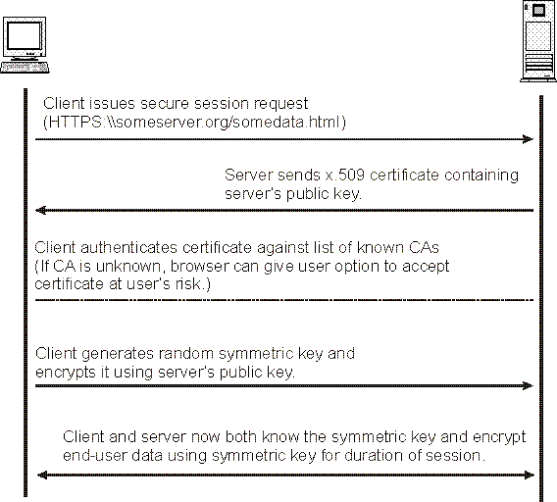
SSL Handshake
A HTTP-based SSL connection is always initiated by the client using a URL starting with https:// instead of with http://.
At the beginning of an SSL session, an SSL handshake is performed
This handshake produces the cryptographic parameters of the session.

Slide 29
References
RFC-2616: http://www.w3.org/Protocols/rfc2616/rfc2616.html
TCP GUIDE: http://www.tcpipguide.com/free/t_TCPIPHypertextTransferProtocolHTTP.htm
IBM Software Information Center - The HTTP protocol http://publib.boulder.ibm.com/infocenter/cicsts/v3r1/topic/com.ibm.cics.ts31.doc/dfhtl/topics/dfhtl29.htm

